Slide 1
Advanced techniques for Natural Language Generation
Chang Liu

Slide 2
Outline
Pretraining for natural language generation
GPT2: Language Models are Unsupervised Multitask Learners
MASS: Masked Sequence to Sequence Pre-training for Language Generation
UniLM: Unified Language Model Pre-training for Natural Language Understanding and Generation
Architecture design for language modeling
Ordered Neurons: Integrating Tree Structures into Recurrent Neural Networks
Mogrifier LSTM
Reformer: The Efficient Transformer
Training and generation strategies
Levenshtein Transformer
Training Language GANs from Scratch
The Curious Case of Neural Text Degeneration

Slide 3
1. Pretraining for natural language generation
GPT2: Language Models are Unsupervised Multitask Learners
MASS: Masked Sequence to Sequence Pre-training for Language Generation
UniLM: Unified Language Model Pre-training for Natural Language Understanding and Generation

Slide 4
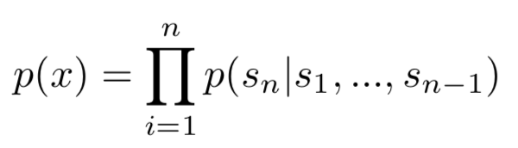
GPT2
Overview
GPT2 is a left-to-right auto-regressive language model with extremely big Transformer and extremely big (and diverse) training corpus. Or in other words, it is a GPT with more model parameters and more training data.
It is skilled at text continuation.
It is actually an analysis paper which explore the landscape of generative pretraining.

Slide 5
MASS
Overview
By corrupting inputs in the encoder side and reconstructing them in the decoder side, MASS can jointly pretrain the encoder, the decoder and the decoder-encoder attention modules in an unsupervised fashion.
The first model (to my knowledge) to adopt denoising-based pretraining objective into seq2seq generation.

Slide 6
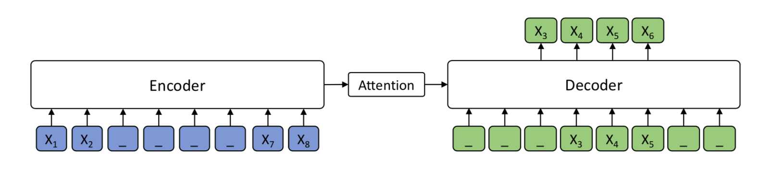
MASS
Method
MASS adopts the encoder-decoder framework to reconstruct a sentence fragment given the remaining part of the sentence: its encoder takes a sentence with randomly masked fragment (several consecutive tokens) as input, and its decoder tries to predict this masked fragment.

Slide 7
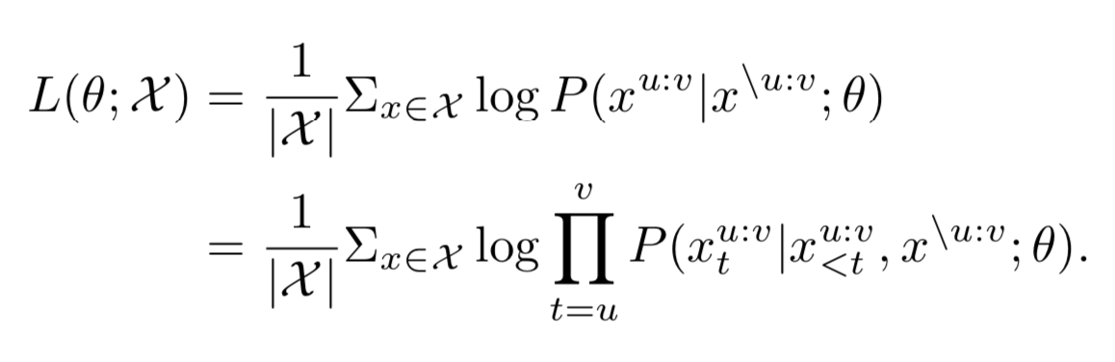
MASS
Method

Slide 8
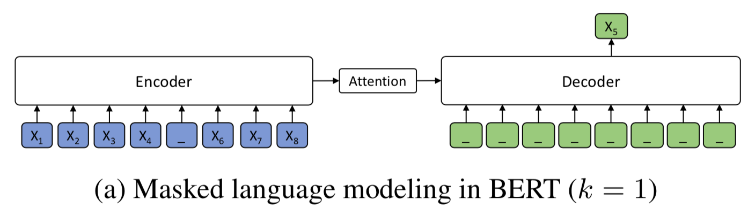
MASS
Method
When k=1, MASS becomes the masked language modeling as used in BERT, where the fully connected layer is replaced by the MASS decoder.

Slide 9
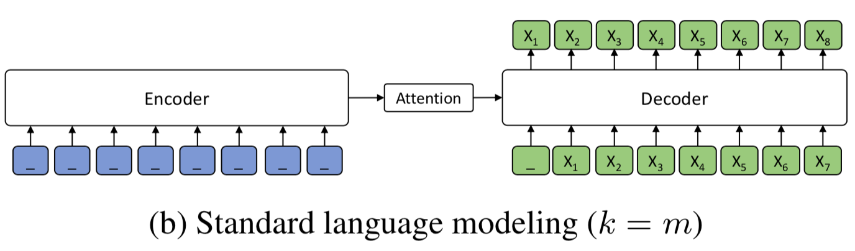
MASS
Method
When k=m, i.e., the all the tokens on the encoder side are masked and the decoder needs to predict all tokens given previous tokens, MASS becomes the standard left-to-right auto-regressive language model as GPT.

Slide 10
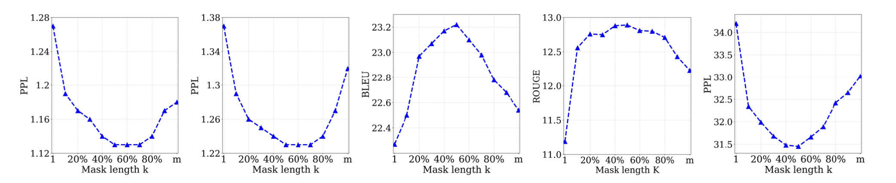
MASS
Experiments:
Model:
Transformer with 6-layer encoder and 6-layer decoder with 1024 embed- ding/hidden size and 4096 feed-forward filter size.
Dateset:
Neural machine translation: 190M English, 62M French and 270M German 2.9M Romanian.
Abstractive summarization: 190M English.
Conversational Response Generation: 190M English.
The choice of k: 50%

Slide 11
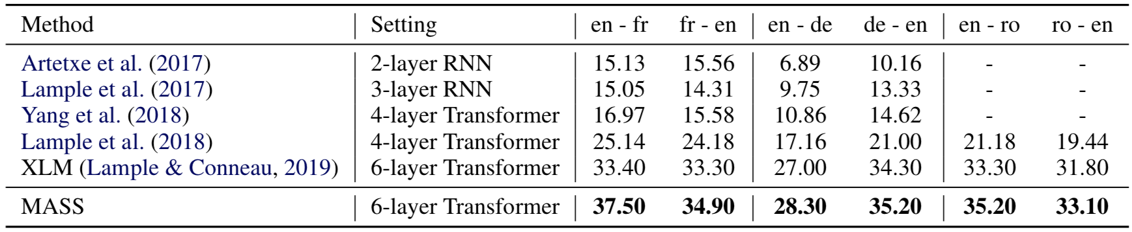
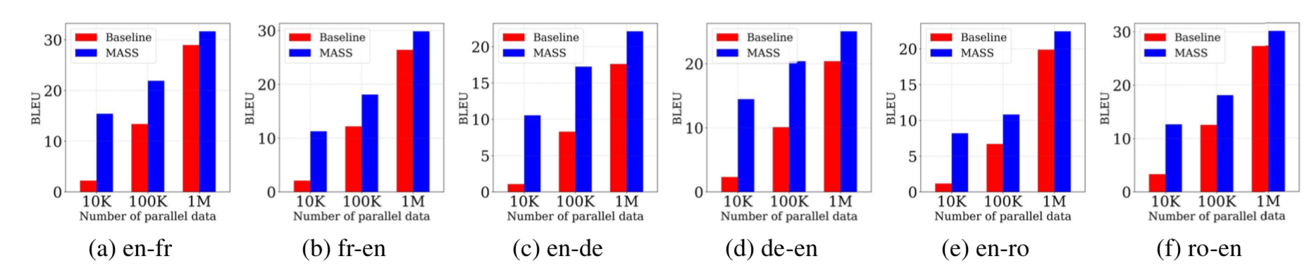
MASS
Experiments
Unsupervised neural machine translation
low-resource neural machine translation

Slide 12
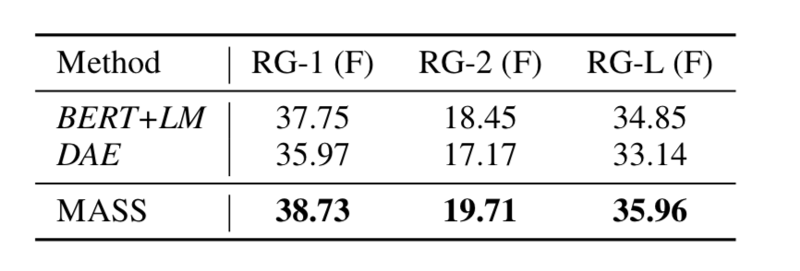
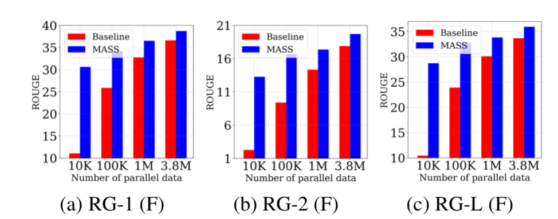
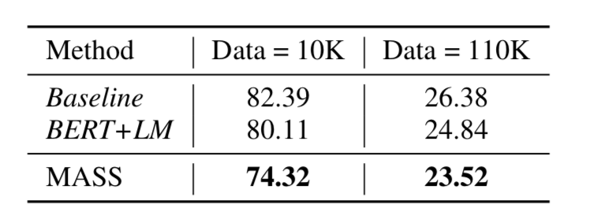
MASS
Experiments
Abstractive summarization
Conversational response generation

Slide 13
UniLM
Overview
UniLM is pre-trained using three types of language modeling objectives: unidirectional, bidirectional, and sequence-to-sequence prediction. The unified modeling is achieved by employing a shared Transformer network and utilizing specific self-attention masks to control what context the prediction conditions on.
It can be fine-tuned for both natural language understanding and generation tasks.

Slide 14
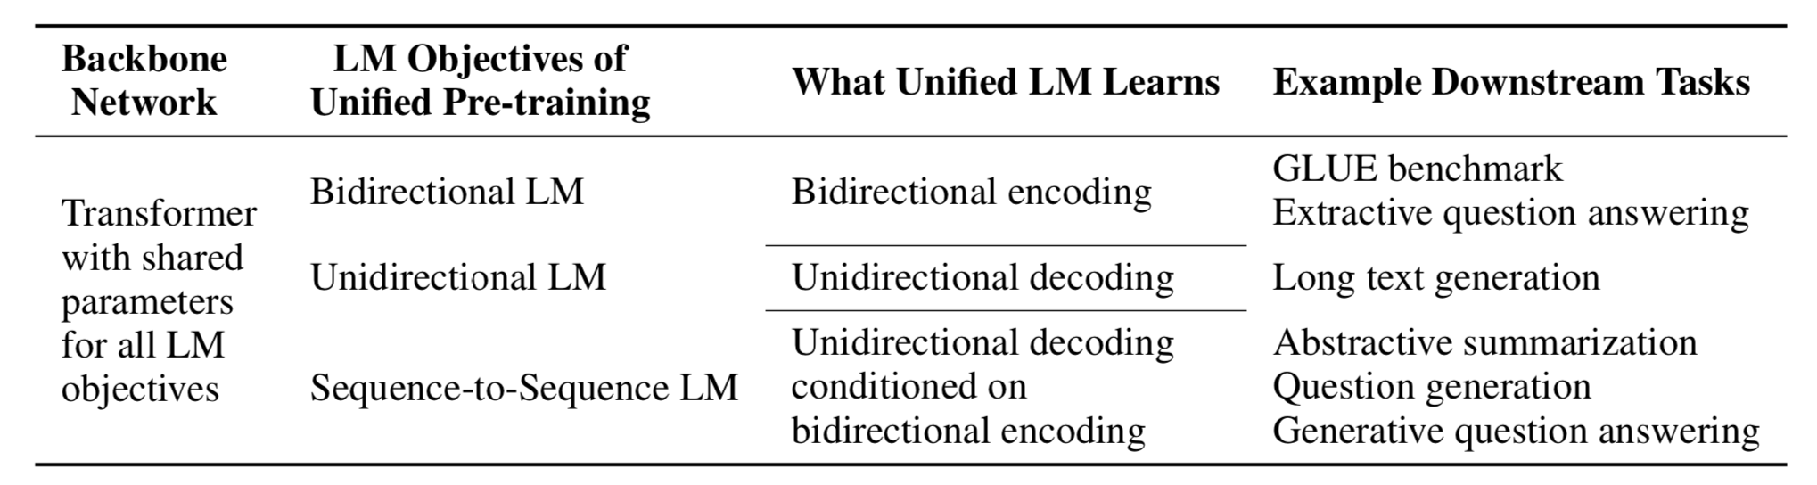
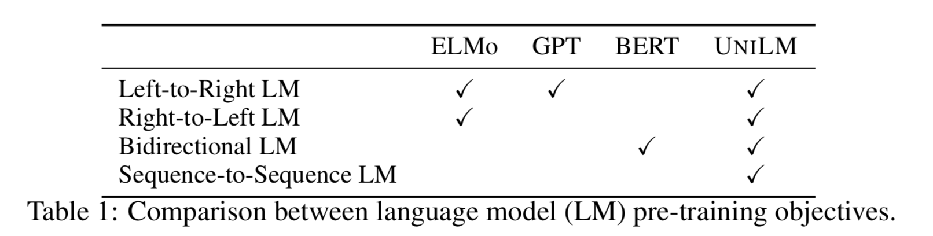
UniLM
Method
Three types of language modeling objectives:

Slide 15
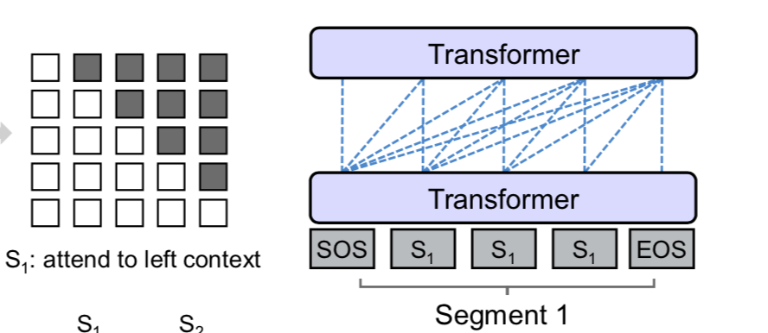
UniLM
Three types of language modeling objectives
Unidirectional LM
Using both left-to-right and right-to-left LM objectives.
Take the left-to-right LM as an example. The representation of each token encodes only the leftward context tokens and itself. This is done by using a triangular matrix for the self-attention mask M.

Slide 16
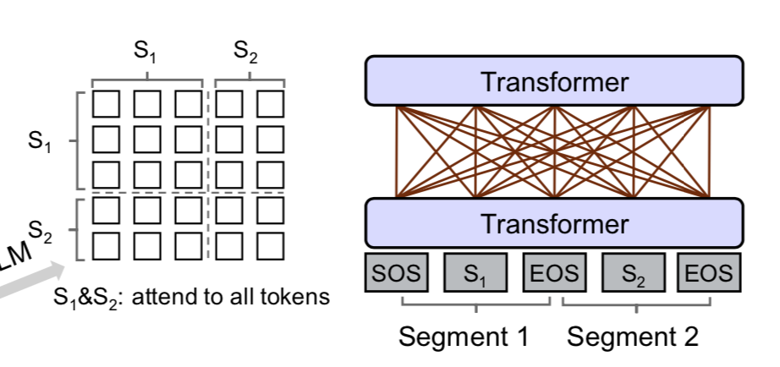
UniLM
Three types of language modeling objectives
Bidirectional LM
A bidirectional LM allows all tokens to attend to each other in prediction.
The self-attention mask M is a zero matrix, so that every token is allowed to attend across all positions in the input sequence.

Slide 17
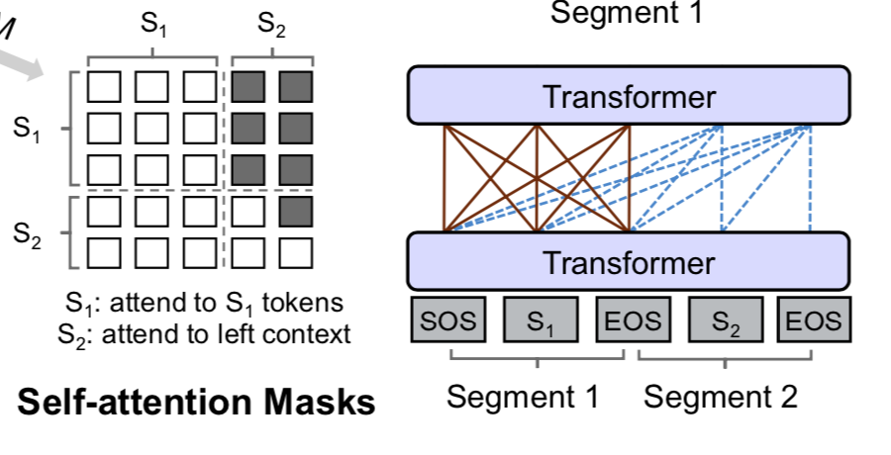
UniLM
Three types of language modeling objectives
Sequence-to-Sequence LM
The tokens in the first (source) segment can attend to each other from both directions within the segment, while the tokens of the second (target) segment can only attend to the leftward context in the target segment and itself, as well as all the tokens in the source segment.

Slide 18
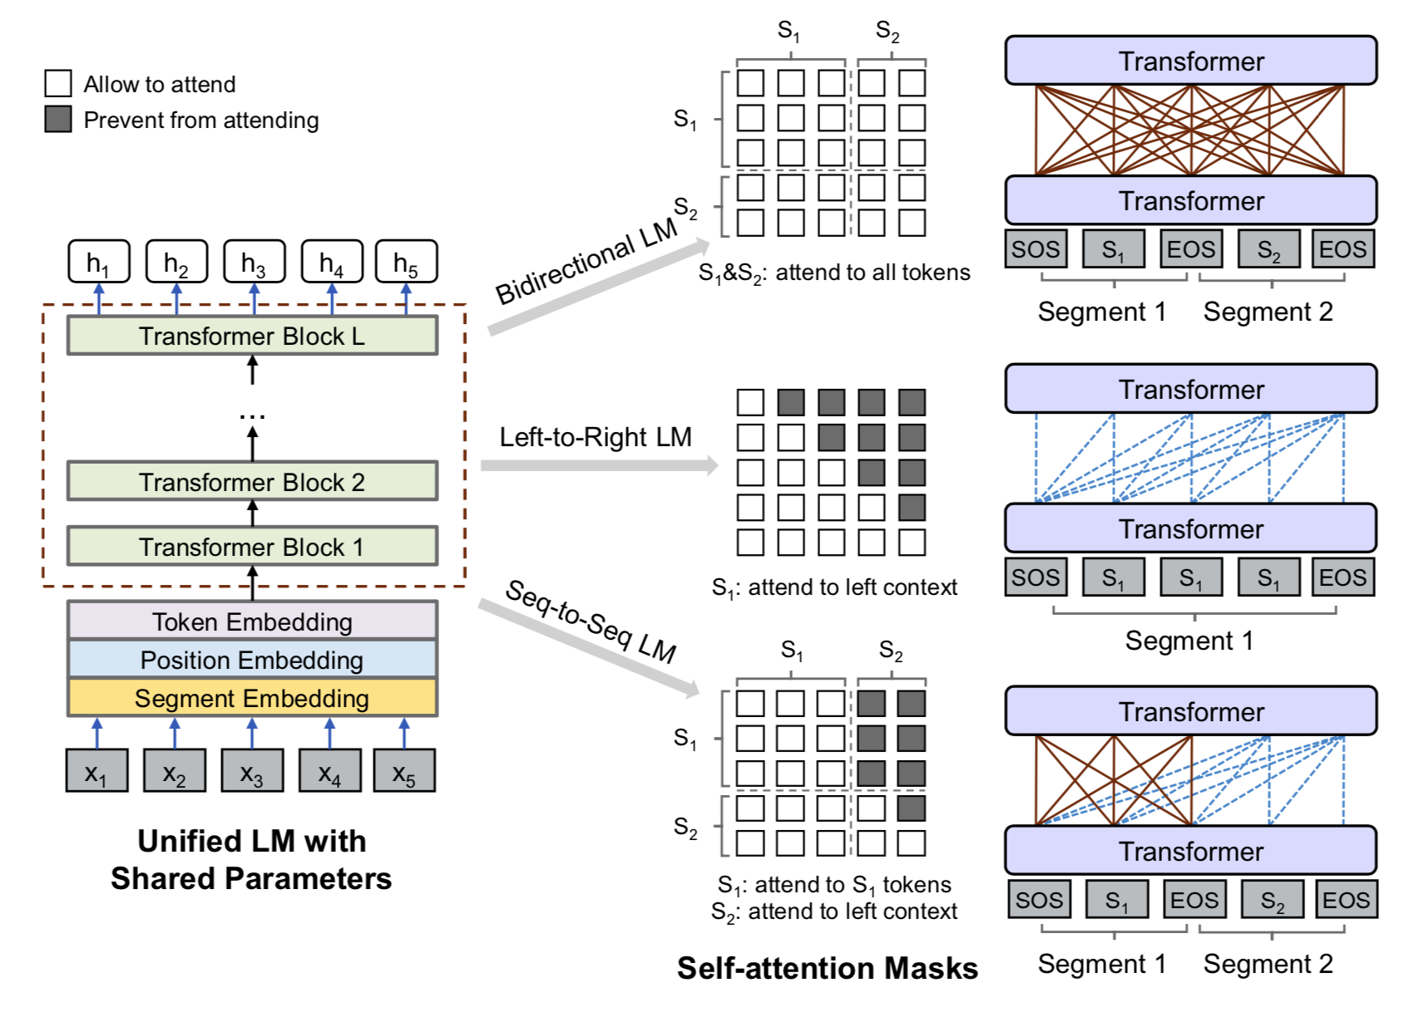
UniLM
Method
Overview

Slide 19
UniLM
Experiments
Model and dataset
Almost the same with BERT_{large}
Pretraining
1/3 Unidirectional LM, 1/3 Bidirectional LM, 1/3 Sequence-to-Sequence LM
The token masking probability is 15%. Among masked positions, 80% of the time we replace the token with [MASK], 10% of the time with a random token, and keeping the original token for the rest.
In addition, 80% of the time we randomly mask one token each time, and 20% of the time we mask a bigram or a trigram.
Finetuning
NLU: similar to BERT.
NLG: The model is fine-tuned by masking some percentage of tokens in the target sequence at random, and learning to recover the masked words.

Slide 20
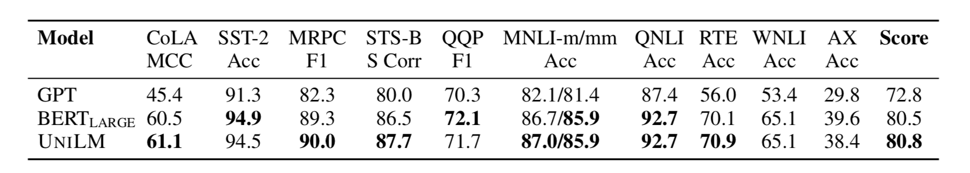
UniLM
Experiments
Natural language understanding on GLEU

Slide 21
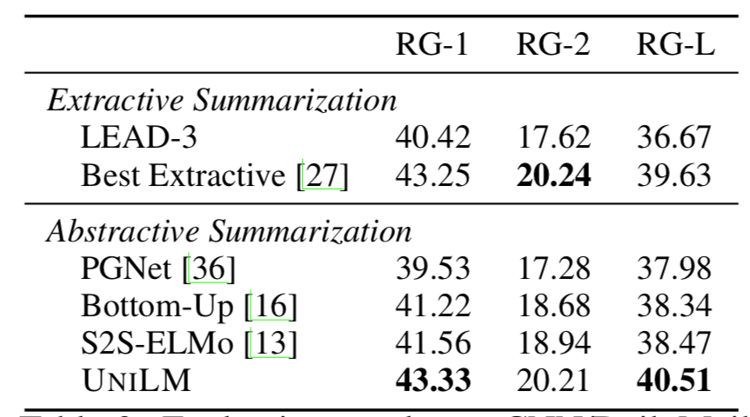
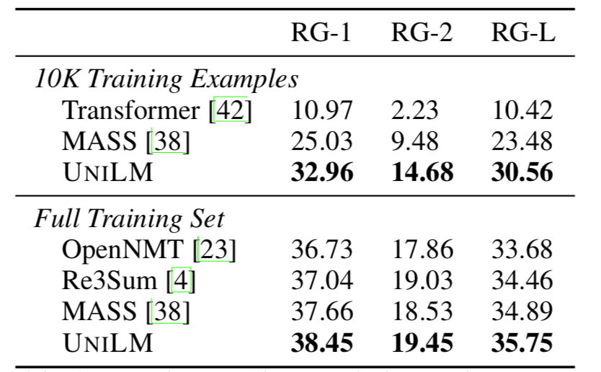
UniLM
Experiments
Natural language Generation on summarization, QA, etc.

Slide 22
GPT, MASS and UniLM
Configuration:
GPT2: (extremely) large Transformer, extremely big and diverse monolingual corpus
MASS: (relatively) small Transformer, multilingual data from WMT
UniLM: (relatively) large Transformer, monolingual data as used by BERT
Motivation:
GPT2: Left-to-right auto-regressive language modeling more model parameters
and more data.
MASS: Adapting the BERT-style mass-prediction objective into seq2seq framework.
UniLM: Unifying GPT, BERT, and seq2seq (different from MASS) objective into Transformer.

Slide 23
GPT, MASS and UniLM
Ability:
GPT2: zero-shot / low resource text continuation
MASS: zero-shot / low resource seq2seq generation.
UniLM: finetuning for both NLU and NLG (text continuation and seq2seq generation)
Differences in generation:
GPT2: share encoder and decoder, tailored for text continuation, generating by feeding previous outputs.
MASS: separate encoder and decoder, tailored for seq2seq generation, generating by feeding previous outputs.
UniLM: share decoder and encoder, tailored for text continuation and seq2seq generation (maybe less powerful compared with MASS), generating by sequential mask-prediction.

Slide 24
2. Architecture design for language modeling
Ordered Neurons: Integrating Tree Structures into Recurrent Neural Networks
Mogrifier LSTM
Reformer: The Efficient Transformer (memory efficiency)

Slide 25
Ordered Neurons
Overview
Natural language is hierarchically structured: smaller units (e.g., phrases) are nested within larger units (e.g., clauses).
The introduced inductive bias: the neurons in LSTM’s memory cell should be ordered: high-ranking neurons will store long-term information which is kept for a large number of steps, while low-ranking neurons will store short-term information that can be rapidly forgotten.

Slide 26
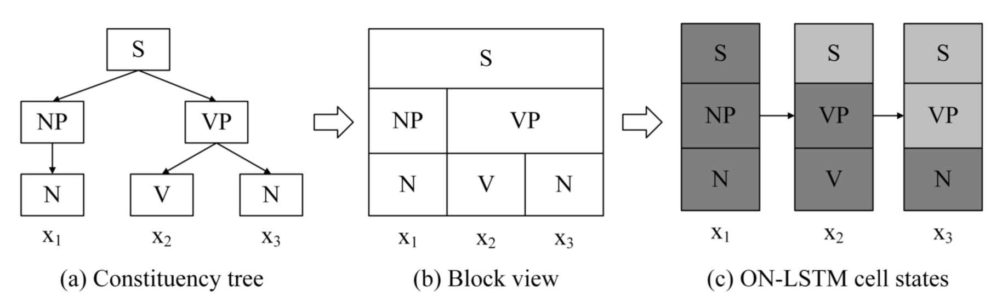
Ordered Neurons
Hierachical structures of human languages.
At each time step, given the input word, dark grey blocks are completely updated while light grey blocks are partially updated. The three groups of neurons have different update frequencies. Topmost groups update less frequently while lower groups are more frequently updated.

Slide 27
Ordered Neurons
The injected inductive bias in LSTM cells
High-ranking neurons contain long-term or global information that will last anywhere from several time steps to the entire sentence, representing nodes near the root of the tree.
Low-ranking neurons encode short-term or local information that only last one or a few time steps, representing smaller constituents.

Slide 28
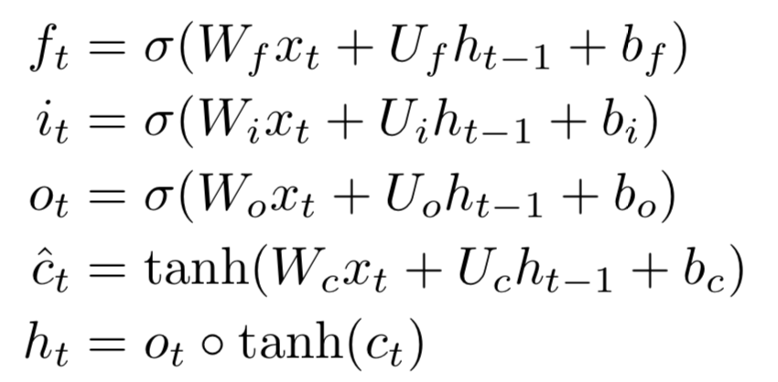
Ordered Neurons
LSTM structure

Slide 29
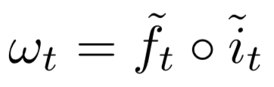
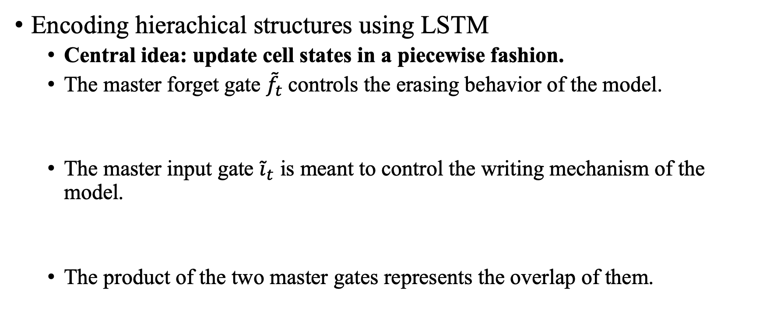
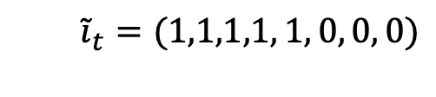
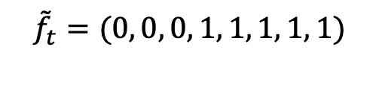
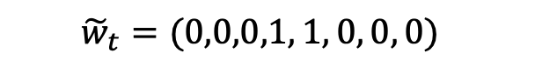
Ordered Neurons
Encoding hierachical structures using LSTM
Central idea: update cell states in a piecewise fashion.
The master forget gate ${\tilde{f}}_{t}$controls the erasing behavior of the model.
The master input gate ${\tilde{i}}_{t}$ is meant to control the writing mechanism of the model.
The product of the two master gates represents the overlap of them.
$${\tilde{f}}_{t}=(0, 0, 0, 1, 1, 1, 1, 1)$$
$${\tilde{i}}_{t}=(1,1,1,1, 1, 0, 0, 0)$$
$${\tilde{w}}_{t}=(0,0,0,1, 1, 0, 0, 0)$$

Slide 30
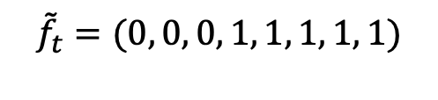
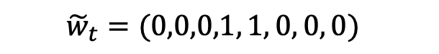
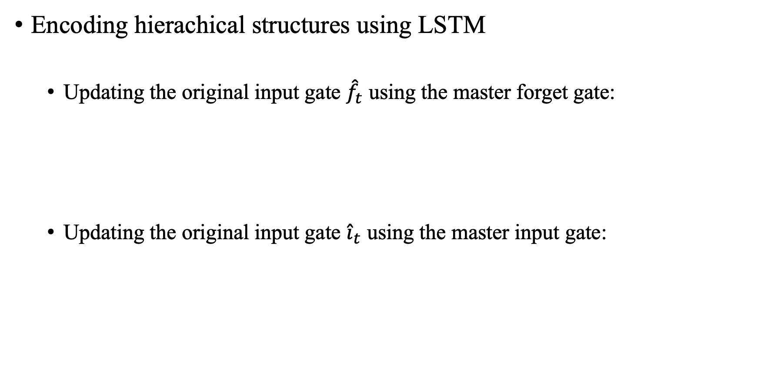
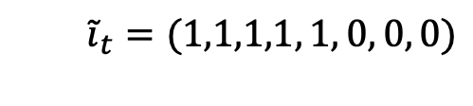
Ordered Neurons
Encoding hierachical structures using LSTM
Updating the original input gate ${\hat{f}}_{t}$ using the master forget gate:
Updating the original input gate ${\hat{i}}_{t}$ using the master input gate:
$${\tilde{f}}_{t}=(0, 0, 0, 1, 1, 1, 1, 1)$$
$${\tilde{i}}_{t}=(1,1,1,1, 1, 0, 0, 0)$$
$${\tilde{w}}_{t}=(0,0,0,1, 1, 0, 0, 0)$$
${\hat{f}}_{t}=\left(0, 0, 0, 1, 1, 0, 0, 0\right) o f_{t}$ + $(0, 0, 0, 0, 0, 1, 1, 1)$ $=(0, 0, 0,f_{t,3},f_{t,4},1, 1, 1)$
${\hat{i}}_{t}=\left(0, 0, 0, 1, 1, 0, 0, 0\right) o i_{t}$ + $(1, 1, 1, 0, 0, 0, 0, 0)$ $=(1, 1, 1,i_{t,3},i_{t,4},0, 0, 0)$

Slide 31
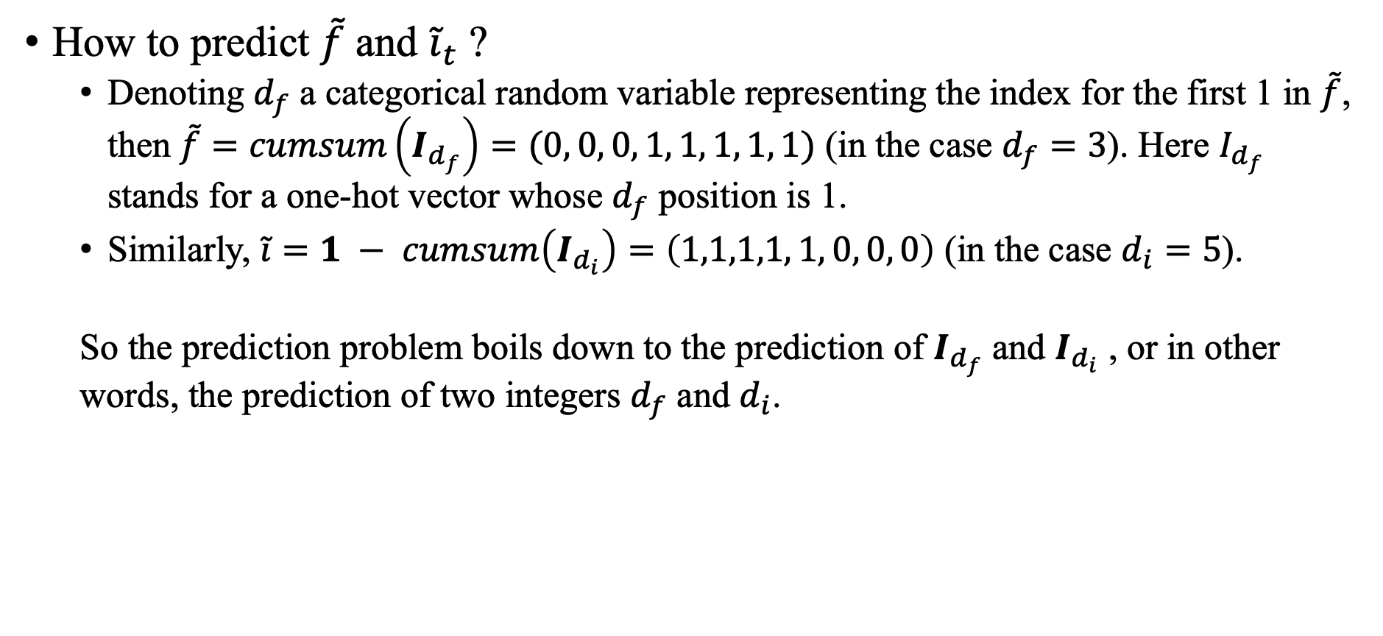
Ordered Neurons
How to predict $\tilde{f}$ and ${\tilde{i}}_{t}$ ?
Denoting $d_{f}$ a categorical random variable representing the index for the first 1 in $\tilde{f}$, then $\tilde{f}=cumsum\left(I_{d_{f}}\right)=(0, 0, 0, 1, 1, 1, 1, 1)$ (in the case $d_{f}=3$). Here $I_{d_{f}}$ stands for a one-hot vector whose $d_{f}$ position is 1.
Similarly, $\tilde{i}=1 − cumsum\left(I_{d_{i}}\right)=\left(1,1,1,1, 1, 0, 0, 0\right)$ (in the case $d_{i}=5$).
So the prediction problem boils down to the prediction of $I_{d_{f}}$ and $I_{d_{i}}$ , or in other words, the prediction of two integers $d_{f}$ and $d_{i}$.

Slide 32
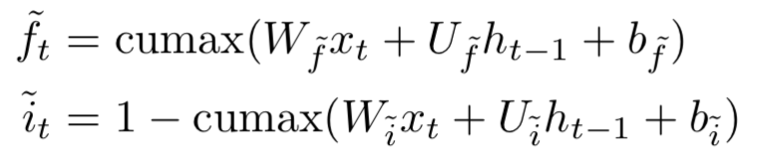
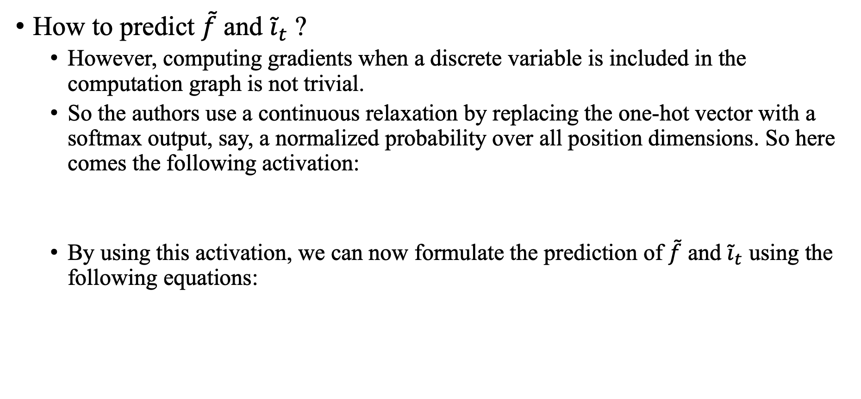
Ordered Neurons
How to predict $\tilde{f}$ and ${\tilde{i}}_{t}$ ?
However, computing gradients when a discrete variable is included in the computation graph is not trivial.
So the authors use a continuous relaxation by replacing the one-hot vector with a softmax output, say, a normalized probability over all position dimensions. So here comes the following activation:
By using this activation, we can now formulate the prediction of $\tilde{f}$ and ${\tilde{i}}_{t}$ using the following equations:

Slide 33
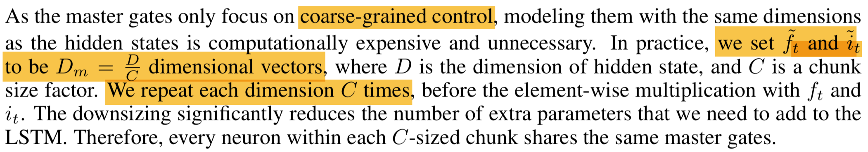
Ordered Neurons
One more thing to notice.

Slide 34
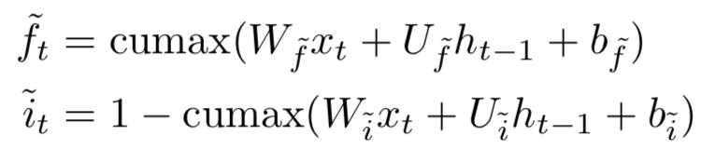
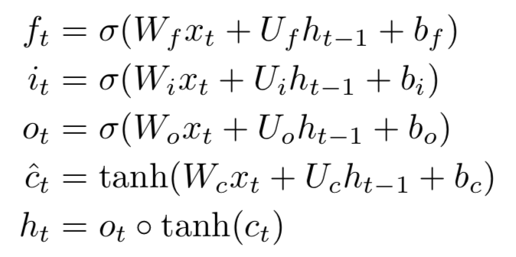
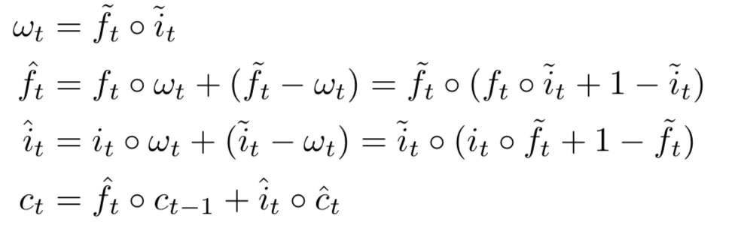
Ordered Neurons
Finally!
2. Prediction of the master input and forget gates
1. Original LSTM calculation
3. Update of the original input and forget gates

Slide 35
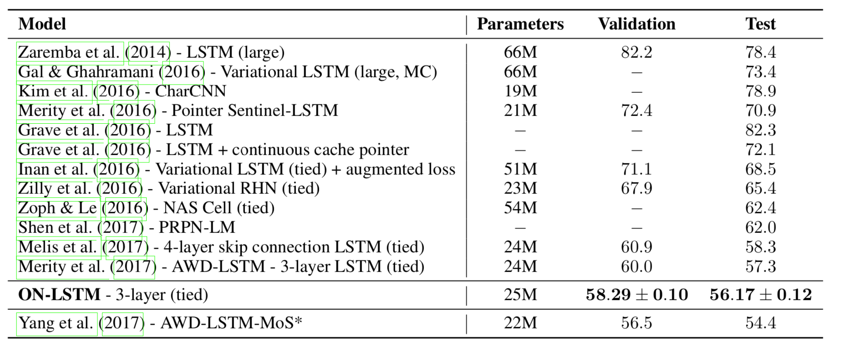
Ordered Neurons
Experiments
Language modeling
Unsupervised Constituency parsing (pls refer to the original paper)

Slide 36
Mogrifier LSTM
Overview
Many advances in Natural Language Processing have been based upon more expressive models for how inputs interact with the context in which they occur.
The Mogrifier LSTM is an LSTM where two inputs x and h_{prev} modulate one another in an alternating fashion before the usual LSTM computation takes place.
By allowing the context to amplify salient and attenuate nuisance features in the input embeddings and vise versa, Mogrifier LSTM enables to model a richer space of interactions between inputs and their context so as to get a more context-relevant input as well as a input-relevant context.

Slide 37
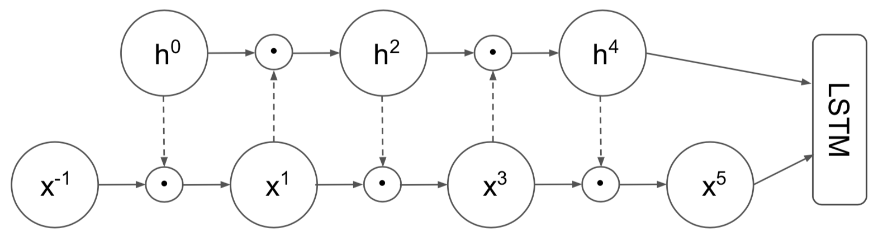
Mogrifier LSTM
Method
The LSTM’s input x is gated conditioned on the output of the previous step h_{prev}. Next, the gated input is used in a similar manner to gate the output of the previous time step. After a couple of rounds of this mutual gating, the last updated x and h_{prev} are fed to an LSTM.

Slide 38
Mogrifier LSTM
Method

Slide 39
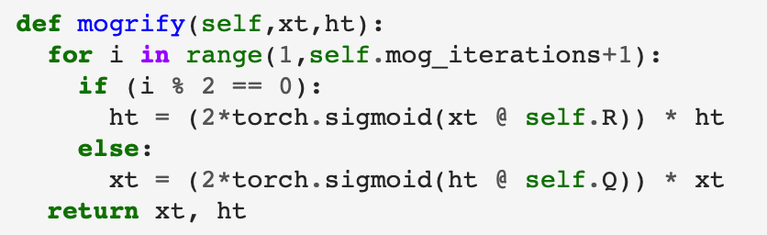
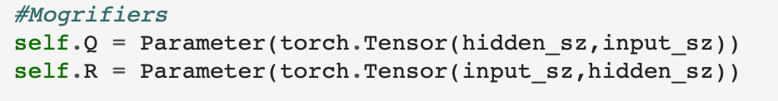
Mogrifier LSTM
Method

Slide 40
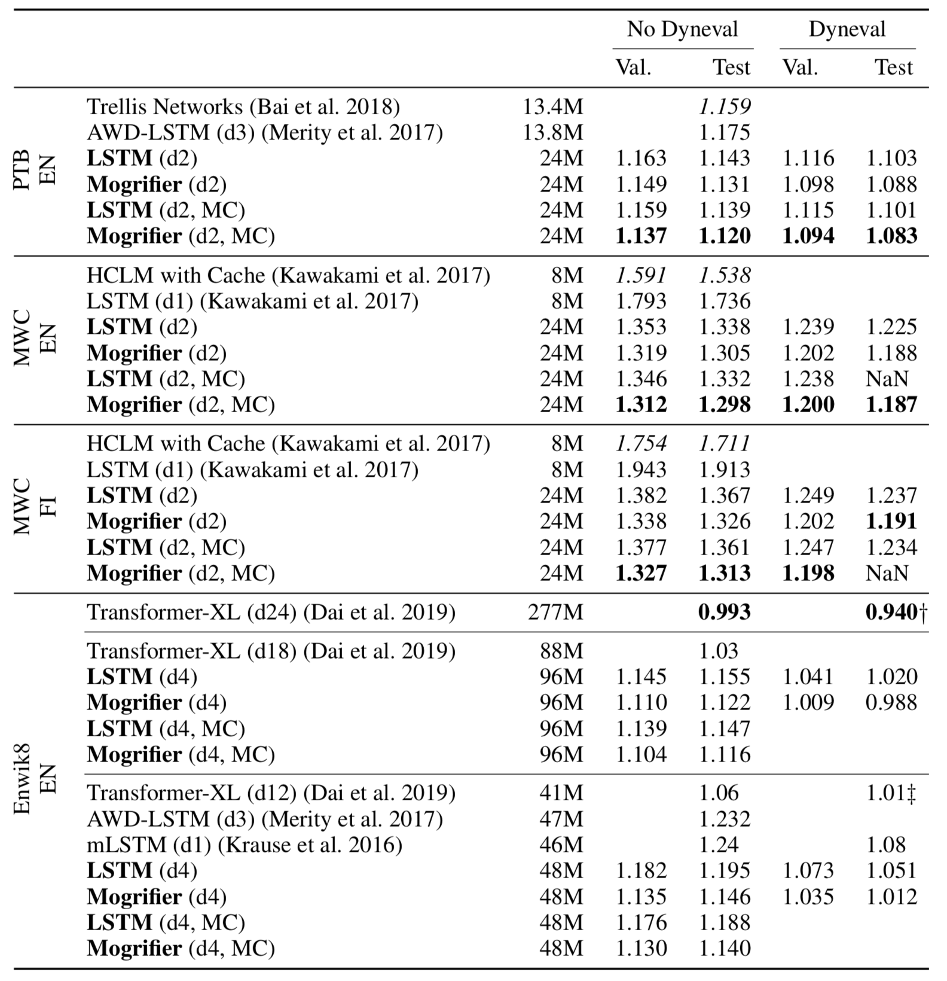
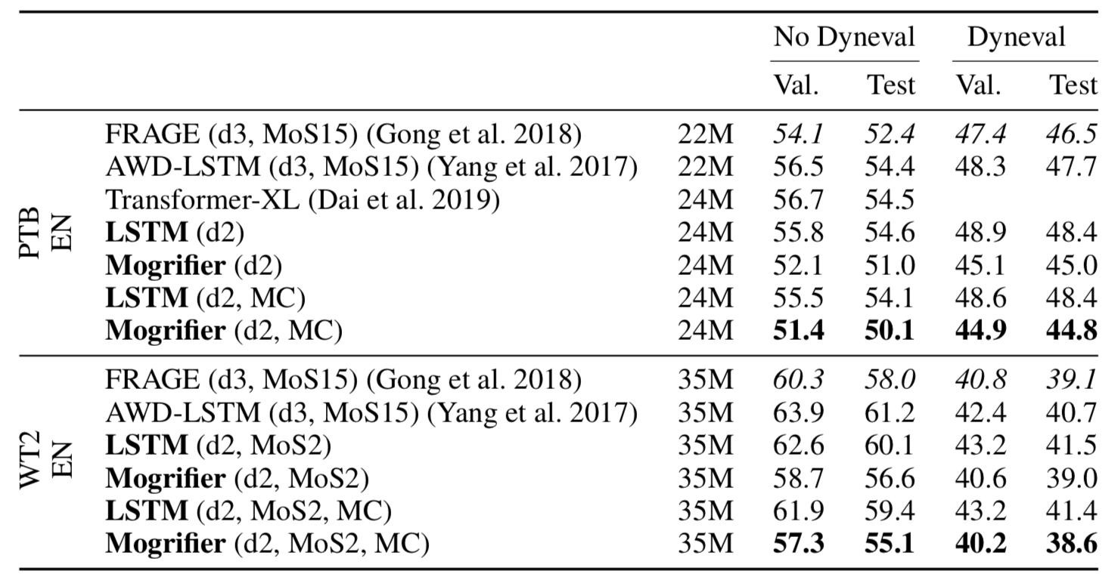
Mogrifier LSTM
Experiments
Language modeling at word level(left)
and char level.

Slide 41
Reformer
Overview:
Locality-sensitive hashing:
The paper replaces dot-product attention by one that uses locality-sensitive hashing, changing its complexity from O(L2 ) to O(L log L), where L is the length of the sequence.
Reversible residual layers:
Furthermore, we use reversible residual layers instead of the standard residuals, which allows storing activations only once in the training process instead of N times, where N is the number of layers.
Chunking FFN layers.
Recommended reading: Reformer (if interested)
Other interesting variations of Transformer: Transformers (if interested)

Slide 42
3. Training and generation strategies
Levenshtein Transformer (novel generation paradigm)
Training Language GANs from Scratch (training)
The Curious Case of Neural Text Degeneration (decoding)

Slide 43
Levenshtein Transformer
Overview
A novel sequence generation paradigm which is the first to facilitate not only generation but also sequence refinement using two iterative operations: deletion and insertion.
A new family of sequence generation: non-autoregressive generation.

Slide 44
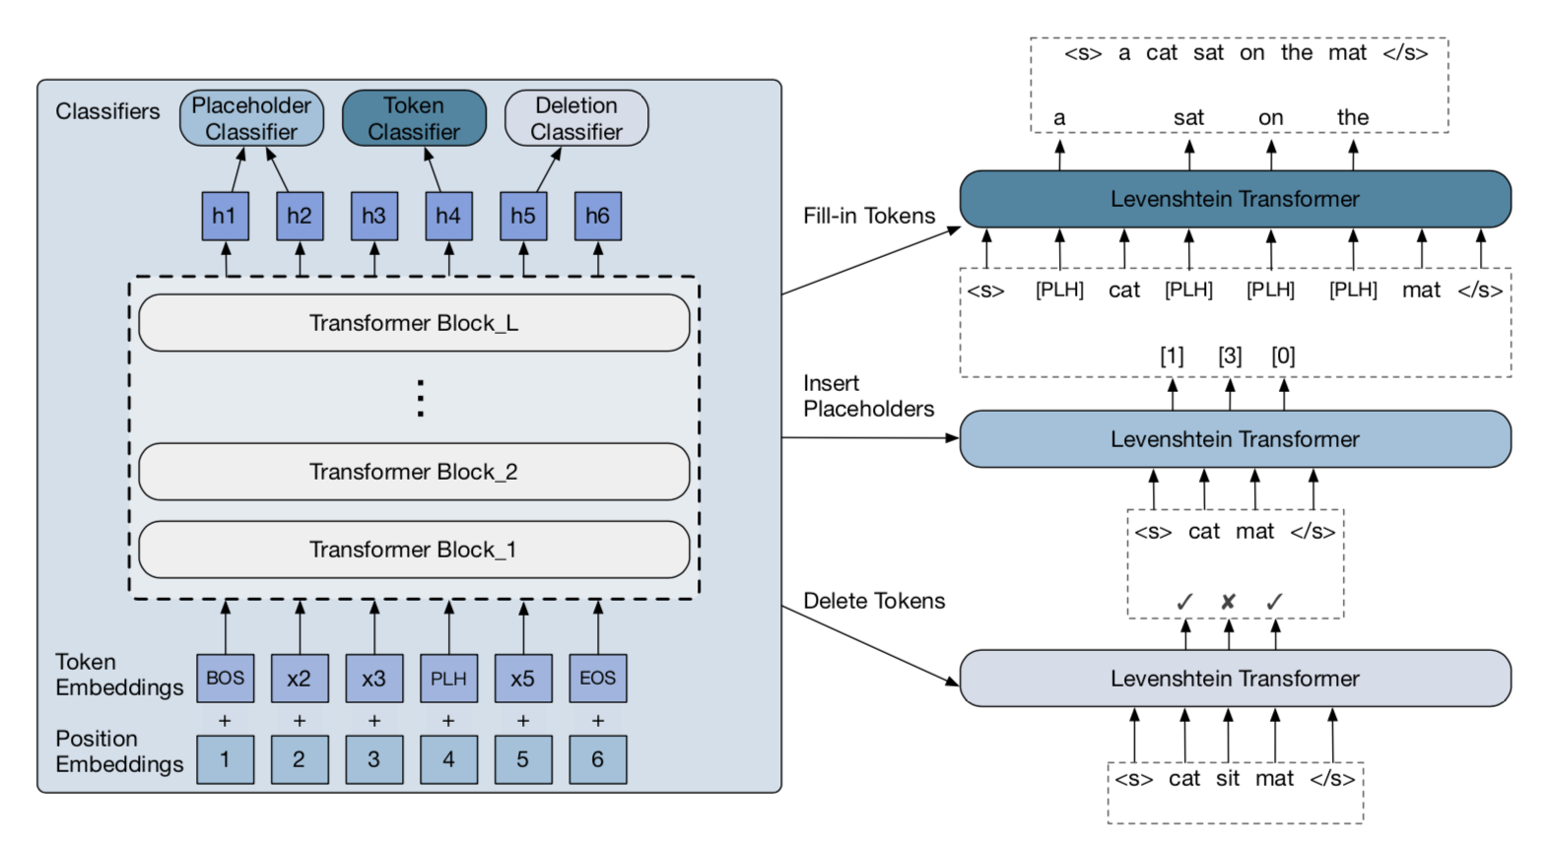
Levenshtein Transformer
Method: three steps in one iteration
Delete tokens
Insert placeholders
Fill-in tokens
In each step, the
predicting process
runs in parallel.

Slide 45
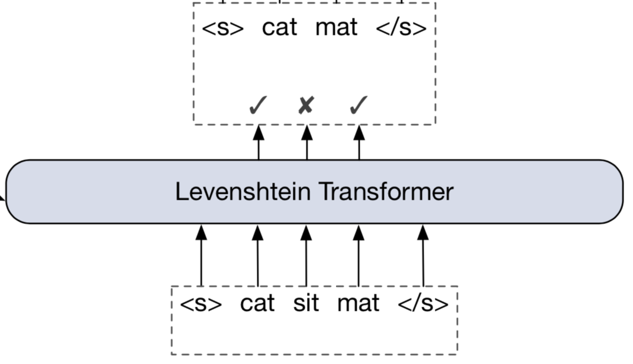
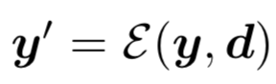
Levenshtein Transformer
Method: three steps in one iteration
Delete tokens using a Deletion Classifier
This operation results in a new sequence, denoted as .

Slide 46
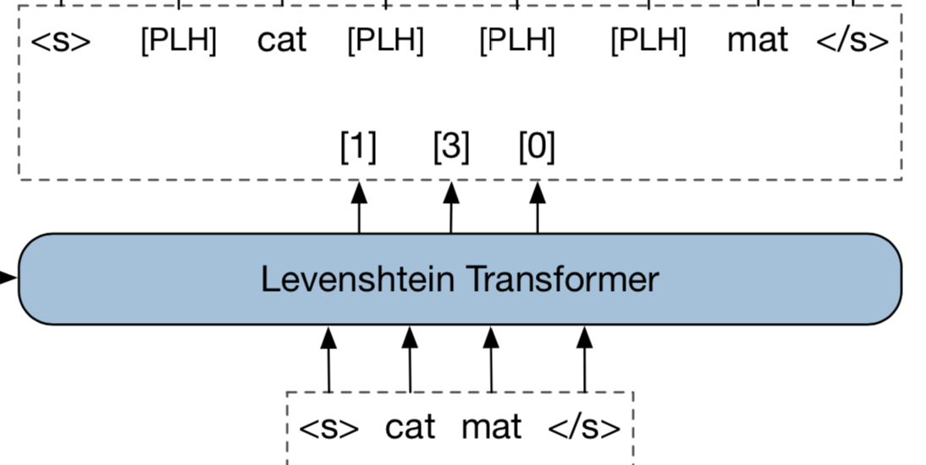
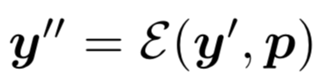
Levenshtein Transformer
Method: three steps in one iteration
Insert placeholders using Placeholder Classifier
This operation results in a new sequence, denoted as .

Slide 47
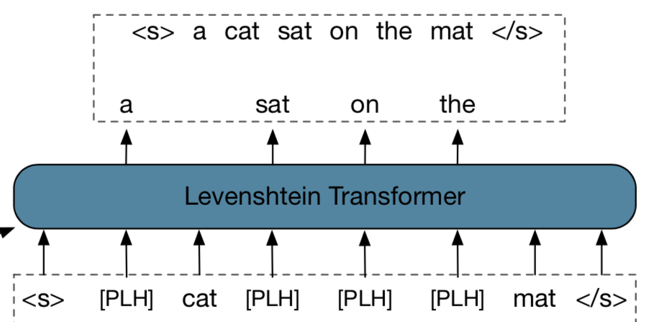
Levenshtein Transformer
Method: three steps in one iteration
Fill-in tokens using Token Classifier
This operation results in a final sequence.

Slide 48
Levenshtein Transformer
Method: three steps in one iteration
Fill-in tokens using Token Classifier
This operation results in a final sequence.

Slide 49

Levenshtein Transformer
Training
The model is trained using imitation learning.

Slide 50

Levenshtein Transformer
Training
The model is trained using imitation learning.

Slide 51


Levenshtein Transformer
Training
The expert actions is defined as follows, where D denotes Levenshtein distance.
The target sequence $y^{∗}$ has two choices:
The ground truth target sequence. (oracle)
The beam-search result of an auto-regressive teacher-model. (sequential knowledge distillation)

Slide 52
Levenshtein Transformer
Inference
Greedy decoding:
Greedily pick up the actions associated with the highest probabilities in all the three classifiers.
Termination condition:
Looping: if two consecutive refinement iterations return the same output.
Timeout: when reaches the maximum number of iterations.

Slide 53

Levenshtein Transformer
Experiments
Machine translation
Text summarization
The surprising power of
iteratively refinement.

Slide 54
Training Language GANs from Scratch
Overview
The paper shows it is in fact possible to train a language GAN from scratch — without maximum likelihood pre-training.
Bag of tricks for training language GAN: The paper combine existing techniques such as large batch sizes, dense rewards and discriminator regularization to stabilize and improve language GANs.

Slide 55

Training Language GANs from Scratch
Preliminaries
The sequential and discrete nature of text has made the application of GANs to language challenging, with fundamental issues such as difficult gradient estimation.
Backpropagating through a sampling operation is non-differentiable, forcing the language GAN practitioner to choose between high variance, unbiased estimators such as REINFORCE, or lower variance, but biased estimators, such as the Gumbel-Softmax trick.
Existing language GANs avoid these issues by pre-training models with maximum likelihood and limiting the amount of adversarial fine tuning by restricting the number of fine-tuning epochs and often using a small learning rate.

Slide 56

Training Language GANs from Scratch
Methods
Dense rewards:
Training a recurrent discriminator which provides rewards for each generated token. The discriminator Dφ learns to distinguish between sentence prefixes coming from real data and sampled sentence prefixes.

Slide 57



Training Language GANs from Scratch
Methods
Large Batch Sizes and global moving-average of rewards for Variance Reduction

Slide 58
Training Language GANs from Scratch
Methods
Discriminator Regularization
Layer normalization.
Dropout.
L2 weight decay.

Slide 59
Training Language GANs from Scratch
However, recent work (shown below) has also shown that when quality and diversity are considered jointly, GAN-generated text fails to outperform generations from language models, which is not in accord with the conclusion in this paper. The effectiveness of GANs in text is still not that clear.
Language GANs falling short.
Evaluating text GANs as language models.
On accurate evaluation of GANs for language generation.
So, let’s step back to MLE-based NLP strategies (again).

Slide 60
The Curious Case of Neural Text Degeneration
Open-ended generation and the problem of degeneration.
Directed generation (translation and summarization) vs
Open-ended generation (conditional story generation and contextual text continuation)
(Likelihood) Maximization-based decoding methods such as beam search lead to degeneration for open-ended generation tasks— output text that is bland, incoherent, or gets stuck in repetitive loops.

Slide 61

The Curious Case of Neural Text Degeneration
Open-ended generation and the problem of degeneration.
The following is produced by GPT-2 Large language model.
Beam search(left): repetition
The highest scores for longer texts are often generic, repetitive, and awkward.
Pure Sampling(right): incoherent
This unreliable tail is composed of tens of thousands of candidate tokens with relatively low probability that are over-represented in the aggregate.

Slide 62

The Curious Case of Neural Text Degeneration
Open-ended generation and the problem of degeneration.
The per-token probability of natural text is, on average, much lower than text generated by beam search.
Natural language rarely remains in a high probability zone for multiple consecutive time steps, instead veering into lower-probability but more informative tokens. Nor does natural language tend to fall into repetition loops, even though the model tends to assign high probability to this
Why is human-written text not the most probable text? Maybe because language models that assign probabilities one word at a time without a global model of the text will have trouble capturing this effect.

Slide 63
The Curious Case of Neural Text Degeneration
Decoding strategies
Deterministic sampling
Greedy sampling (a special case of Beam search where beam_size=1)
Beam search
Stochastic sampling
Random sampling
Top-k sampling
Nucleus sampling (proposed in this paper)

Slide 64


The Curious Case of Neural Text Degeneration
Top-k sampling
At each time step, the top k possible next tokens are sampled from according to their relative probabilities.
Define its top-k vocabulary V (k) ⊂ V as the set of size k which maximizes
Let . The original distribution is re-scaled to a new distribution, from which the next word is sampled:

Slide 65

The Curious Case of Neural Text Degeneration
Sampling with temperature
Given the logits u_{1:|V |} and temperature t, the softmax is re-estimated as
Setting t ∈ [0, 1) skews the distribution towards high probability events, which implicitly lowers the mass in the tail distribution.
Low temperature sampling sharps the distribution and has also been used to partially alleviate the issues of top-k sampling discussed above.

Slide 66



The Curious Case of Neural Text Degeneration
Nucleus sampling
The key idea is to use the shape of the probability distribution to determine the set of tokens to be sampled from.
Given a distribution P (x|_{x1:i−1} ), we define its top-p vocabulary V (p) ⊂ V as the smallest set such that
Let . The original distribution is re-scaled to a new distribution, from which the next word is sampled:

Slide 67
Thanks for listening!

